Slide 1
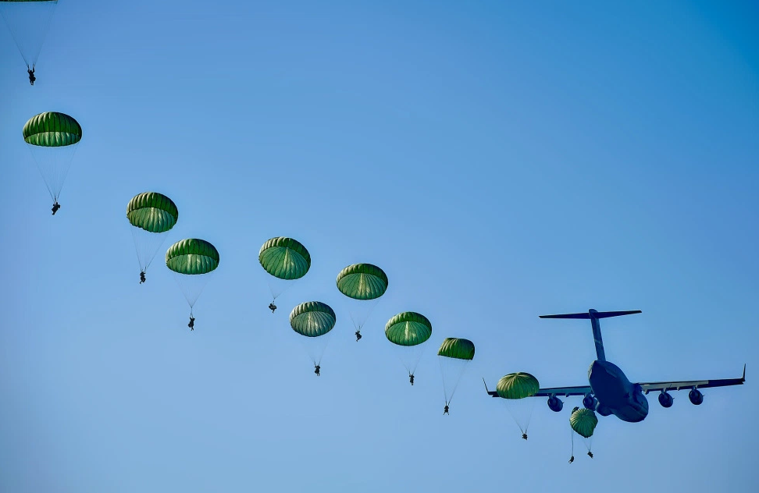
PlayerUnknown's Battlegrounds
Data Analysis Using Spark
Team 6: Beiwen Guo
Zhenyu Zhu

Slide 2
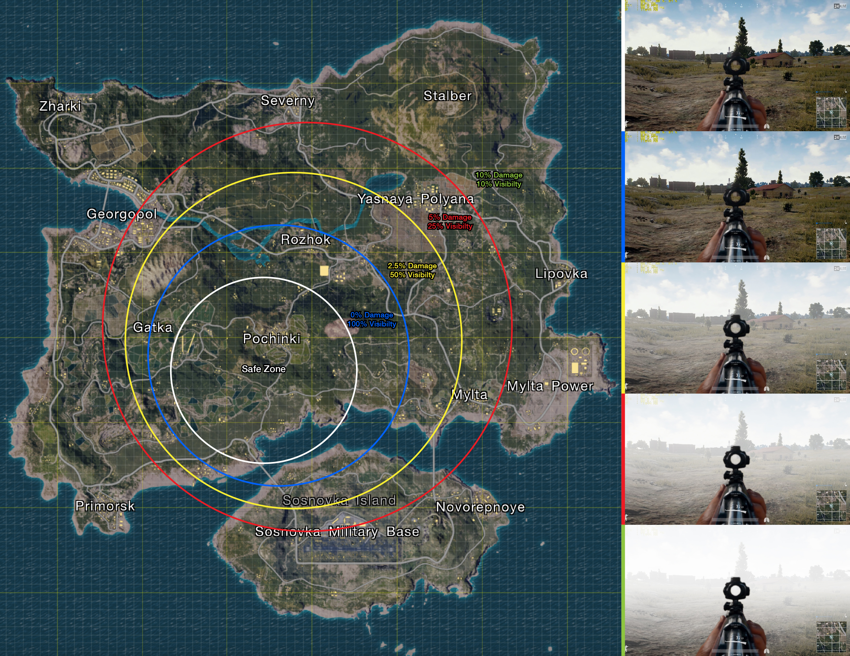
About PUBG :
Notes:
The way to win a match in this game is pretty simple, be the last one who survived. Each match starts with 100 players parachuting from a plane onto a map area approximately 8 by 8 kilometres in size. Once they land, they can search buildings and other sites to find weapons, vehicles，armor, medicine, and other equipment. As a player, you can choose to fight or hide. But you cannot hide for the whole game, because a bluezone (see below) will appear a few minutes into the game to corral players closer and closer together.

Slide 3
Processing and visualizing matches data from the popular video game PUBG to determine if specific strategies or behaviors are related to wining the game.
Our Goals

Slide 4
Individual user:
By inputing corresponding values of one single player's performances in one match, to predict if such a player can be a winner in this match by using trained classification model our project will build.
Use Cases
Business users:
By uploading a number of matches data to our system, they can cluster all players from these matches by play style/strategy. Corresponding plots will be provided.

Slide 5
Methodology
Filtering data
Spark MLlib
AWS
Apache Zeppelin
Discard data which will not be used and ingest data into a useable form .
Building and training model using Spark MLlib.
Using AWS resource to process large scale data.
Using Apache Zeppelin to generate visualization output.

Slide 6
Data Source
All data are from kaggle called PUBG Match Deaths and Statistics. There are two zip files composed of 10 .csv files. Approximately 10 million rows and 20 GB in all.
Reference:
https://www.kaggle.com/skihikingkevin/pubg-match-deaths

Slide 7
Milestones/sprints
3.15
-3.21
3.29 -4.4
Data cleaning and preprocessing.
Continue Implementation.
Spark self-learning.
Train model.
Travis CI set up.
Test cases coding.
3.22-
3.28
4.5 - 4.11
Spark MLlib(Clustering&Classification) self-learning.
Data Visualization.
Starting implementation.
Integration tests.
Zeppelin self-learning.

Slide 8
Programing in Scala
Cleaning, parsing and ingesting data
Building ML Model
Unit Test
Our repository
https://github.com/beiwen/CSYE7200_FinalProject_Team06

Slide 9
Acceptance Criteria
The proportion of data that our project processes should reach to at least 70%.
Classification model can determine if the user is a winner. The accuracy should be at least 70%.

Slide 10
Thank you!

